Slide 1


Get the Most from SAP® BusinessObjects™ BI Solutions with SAP Sybase® IQ
Speaker’s Name/Department (delete if not needed) Month 00, 2012

Slide 2

Agenda
Analytics Market
What is SAP Sybase IQ
Get the Most from your BusinessObjects BI with SAP Sybase IQ
Customer Successes

Slide 3



Do you have actionable insights into your business?
Customer Insights
Which customers & channels are more profitable?
Improve merchandising and customer marketing/loyalty?
Identify growth opportunities?
Product & Service Insights
How are products/services doing vs. the competition?
Track complaints from call centers & social media
Manage inventory; reduce transportation costs?
Operations Insights
Gain real-time visibility across value chain?
Improve agility and increase profit?
Decrease reliance on IT for managed reports?
Notes:
Pick one example to illustrate why clear actionable insights are essential to a thriving business. This slide tries to understand the pain points that resonate with customers. Some line of business’ expectation of how they need clear actionable insights. Engage with customers on a dialogue and prioritize the pain.

Slide 4


Analytics provide proven return on investments
“Organizations earn an average of $10.66 for every dollar spent on deployments of analytics.”
>1000%
“With such high returns, management teams should consider these technologies to be one of the most attractive investment opportunities available to the CFO”
Source: Nucleus Research, “Analytics pays back $10.66 for every dollar spent”, December 2011
Notes:
Analytics can provide actionable insights to your business …and a recent study showed that analytics pays back more than 10$ for every $ spent – more than 1,000% ROI.

Slide 5



What is SAP Sybase IQ?
Performance & Scalability
Trusted Open Platform
Integrated Ecosystem
100x faster than traditional DBMS
Supports heavy ad hoc loads with 1,000s of concurrent users
Store & analyze terabytes to petabytes of structured & unstructured data
#1 column DB for reporting and analytics
Platform for algorithms, services & APIs for Big Data analysis
Highly flexible deployment options; supports all major hardware & O.S. platforms
Best-of-breed partners certified with Sybase IQ
Tight integration with SAP products (HANA, BusinessObjects BI)
Supports 3rd party BI tools and analytic applications
Notes:
SAP understands that the transformative power of business analytics can only be realized when enterprises adopt an approach to analytics that supports power users and the broader community of decision makers and integrates analytics directly into core operational processes. This requires a solution that can meet the needs of all stakeholders across business groups and the IT department. The SAP® Sybase® IQ server delivers high-performance analytics to power dashboards, scorecards, and ad hoc business reports that are needed for fast, cost-effective mission-critical business intelligence. IQ is a columnar disk based OLAP analytics database – it’s columnar database system is built for performance excellence – the advantages you receive are…
Speed from a column-based architecture
100x faster than traditional transactional database technology
High-speed analytics performance handles volumes of ad-hoc queries in “real time”
Scalability and flexibility from Grid Architecture
Supports thousands of users and years of historical and real-time data
Can support both simple and complex analytics for structured and unstructured data
Data Compression
Compression algorithms reduce volume of stored data by up to 70%
Low startup Cost and long-term Low TCO
IQ is the #1 column database in the market today. And, in fact, it has more customers than all the other column database vendors combined! And we win more new customers each year than some vendors have in total.

Slide 6
Get the Most from SAP BusinessObjects BI Solutions with SAP Sybase IQ
Make Big Data Actionable
1
Accelerate Insights Across Your Enterprise
2
Lowest TCO for BusinessObjects BI Data Needs
3
Notes:
While, traditional database systems are failing to satisfy the increased demands for fast answers, accurate insights, and business-critical reports generated with BusinessObjects BI Tools - IQ is able to remove those barriers, therefore enhances the performance of the BusinessObjects BI tools. IQ makes it possible to outsmart the competition, reduce business risks, and lower the cost of reporting. Our technologies accelerate analytics performance up to 100 times against massive data sets. Our built-in cost features reduce costs for all reporting workloads. And, reduce administrative costs by up to 75% with easy management, rapid deployment, and no schema change required.
SAP Sybase IQ allows you to get the most from your BOBJ solutions by:
Making Big Data Actionable
Accelerating Insights Across Your Enterprise
And, offers the Lowest TCO fro BOBJ BI data needs

Slide 7
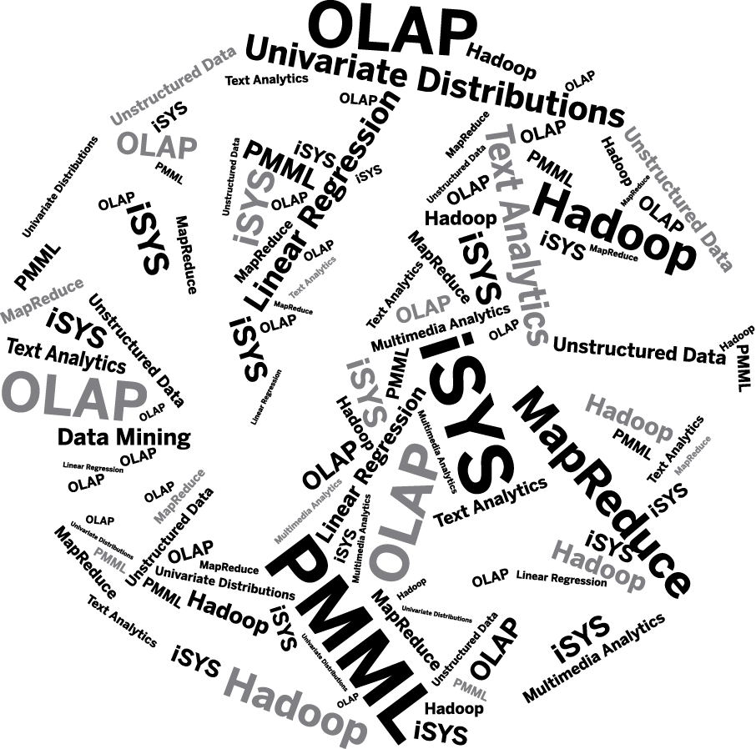
Make Big Data Actionable
One environment for managing all the different data that your applications and business processes need for analytics
Support high volumes of complex queries for business-critical analytics and reporting
Unprecedented scalability using the hardware of your choice
Notes:
SAP Sybase IQ is a powerful solution to help customers address and lever Big Data:
IQ offers one environment for managing all the different data that your applications and business processes need for analytics
Support for high volumes of complex queries for business- critical analytics and reporting
Unprecedented scalability using the hardware of your choice
Reports and ad-hoc queries are run against detailed data instead of aggregates
Trending can be done against decades worth of data, rather than 6-12 months
BI and ad-hoc query capability can be delivered to thousands of front-line workers concurrently
Open up BI environment to self-service and mobile platforms, knowing that neither the volume of users or rogue queries from untrained users will cripple the system
Data doesn’t need to be pre-structured to give reliable response times
You can store structured, transactional data alongside unstructured qualitative data in one place
Multiple sources of data can be easily stored in a single system allowing richer questions

Slide 8

Accelerate Insights Across Your Enterprise
Unsurpassed real-time performance – answer questions up to 100x faster
Empower collaborative decisions with the right people, tools and standards
Supports thousands of users and years’ worth of data
Notes:
IQ accelerates insights across your enterprise by allowing you to deeper drill-down on granular business and financial data using BusinessObjects Suite of BI tools, without ongoing IT intervention (self-service), so that business users can experience a “Google search” effect to better manage the business.
Run quarterly financial reports in hours, not days
Analyze end of day sales analysis for thousands of stores in time for next day store opening
Business managers will run intra-day analysis instead of waiting for end-of-day reports
Reports are run against data that is minutes old, not days or weeks old
Answers can be provided to customers in seconds, while they are still on the phone with the call center
Faster responses allow for train-of-thought analysis, making analysts more productive
Operational decision-making in seconds
IT can focus on new challenges (new sources of data, new types of analysis) rather than spending most of their time fine-tuning to improve performance
Users are not afraid to ask questions, confident that response times will be short and predictable

Slide 9


Lowest TCO for BusinessObjects BI Data Needs
A single vendor for database, application and support
No need to tune & optimize each query – saving DBA resources
Reduces IT complexity while meeting SLAs
Compresses data to save storage and maintenance costs
Notes:
IQ reduces business costs by delivering faster, more flexible BusinessObjects reporting, KPIs, and ad hoc querying to a wide range of business users, without limits on the amount of data or number of users who can access it.
A single vendor for database, application, and support
Protects customers existing investments in reporting and dashboards
Reduce IT complexity while meeting Service Level Agreements
Budget for BI projects can be spent on analysis, ETL, BI platforms and user-training
The compression of data provided by IQ results in significantly lower storage costs
The ability to load at the same time as querying reduces admin pressure on batch windows and reduces SLA breach penalty costs
Uses on average one-third the number of CPUs of relational databases and runs on cost-effective commodity hardware and operating systems
Database administration costs are typically one-third of comparable relational or pure MPP environments
Don’t believe us – let’s see what our customers are saying…

Slide 10


Making Big Data Actionable at BNP Paribas Corporate and Investment Banking
Business Challenges
Provide senior management with a real-time view of liquidities and the bank’s cash position in order to implement appropriate hedging strategies
Fully optimize operational and financial risk management processes to ensure highest levels of performance
Technical Challenges
Providing access for more than 200 users daily to make various types of requests including immediate, pre-defined, complex, and ad hoc reports.
Benefit
Ensures required reliability and security for risk management assessments
Guarantees higher analytical decision-making capacity capabilities for senior management
Reduces business intelligence storage requirements by 75%
Completes critical reports in 3 seconds rather than 30 minutes required by previous system
Reduces system maintenance support costs
600 x increase in reporting speeds
75% reduction in BI storage requirements
“
”
The performance of SAP Sybase IQ, combined with SAP Business Objects, is crucial for our banking activities. The two technologies allow us to obtain a centralized view of liquidity risk that we can now manage in real-time
Applications Manager, BNP Paribas Corporate and Investment Banking
Notes:
BNP Paribas Corporate & Investment Banking (CIB) provides financing, advisory and capital markets services. The company is a globally-recognized leader in many areas of expertise including structured financing and derivatives across a variety of asset classes. BNP Paribas CIB also has a solid corporate advisory franchise in Europe and Asia. The bank is part of the BNP Paribas Group, which is one of the strongest banks in the world as rated by Standard & Poor's and has a presence in more than 80 countries with more than 200,000 employees.
By relying on the combined Sybase/SAP Business Objects business intelligence solution, BNP Paribas CIB saw a 600 times increase in reporting speeds providing information in an actionable time frame driving results and now has a centralized view of global liquidity and treasury activity so that senior management can manage risk more effectively in real time.
Key Benefits
•Ensures required reliability and security for risk management assessments
•Guarantees higher analytical decision-making capacity capabilities for senior management
•Reduces business intelligence storage requirements by 75%
•Completes critical reports in three seconds rather than 30 minutes required by previous system
•Reduces system maintenance support costs
Sybase Technology
Sybase IQ
SAP BusinessObjects
Sybase ASE
Sybase Replication Server

Slide 11

Accelerated Insights Across LandesBank Berlin
Single
Management System
Business Challenges
Consolidate all capital market department information into a single data store that represented a single version of the truth and that could also be accessed by management, traders, sales people and others when needed
Technical Challenges
Create a single management information system that would enable users to generate reports, run queries, create interactive dashboards, and add or structure data in other ways to make optimal business decisions and provide first-rate client service.
Benefit
Provides a single source for immediate, accurate and comprehensive overviews of Capital Markets sales and investments
Query response times 45 times faster than previous RDBMS-based system
Simplifies and speeds data loading into analytics data stores
Reduces maintenance requirements
Reduces costs by decreasing required storage space by 5 times
Improves client service due to system’s rapid response time
45x Faster query response time
Reduced required storage by
5x
“
”
“Combining SAP BusinessObjects and SAP Sybase IQ is the perfect solution to support our business intelligence vision. In the business intelligence system, the database is the least visible but most important part of the solution and SAP Sybase IQ has demonstrated its superiority in that regard in our Capital Markets business”
Tobias Schmitz-Harbauer, Head of the Performance Analysis, Department of the Capital Markets Business, Landesbank Berlin AG

Slide 12

Lowered Costs While Increased Speed At Digiturk
Business Challenges
Required easy data access for 150 employees in departments ranging in marketing, sales, technical service, finance and content, to run ad hoc queries and routine reports on subscribers; sales, cost and profit analyses and more on a daily, weekly and monthly basis.
Technical Challenges
Required constant tuning and special indexing
Consumed an average of 8 hours a day of IT time, constituting a significant drain on the IT department.
Benefit
Query response times 6x faster over previous Oracle DB (even without tuning)
Eliminates the failure of some queries to complete
Enables business users to generate required reports on time
Supports rapid analysis and business decisions required to retain its competitive edge
Reduces daily database maintenance by 75%
Cuts hardware requirements dramatically
6x Faster than previous database (Oracle) with NO tuning
75% Reduction
in daily database maintenance
“
”
“Sybase IQ’s column-based architecture has really made a big difference for us. It’s improved performance dramatically. That has made our end-users happier and it has reduced daily database administration by 75% and cut hardware requirements in half. Sybase IQ delivers better performance at a fraction of the cost.” Tugce Denizlerkurdu, Head of the Decision Support Systems Unit, Digiturk
Notes:
A great customer case study is Digiturk. Digiturk, is a Turkish Satellite television & media provider – who has nearly 3 million subscribers worldwide. They have 150 users from various departments, such as , sales, marketing, finance, etc. They were running BusinessObjects against an Oracle database and performance was lousy. Queries were taking up to 30 minutes, and in some cases timing out. Worse still they had a full-time DBA creating aggregates and indexes in order to try and improve performance.
By replacing Oracle with the Sybase IQ and SAP BusinessObjects Web Intelligence solution.
Sybase IQ drastically improved query response from what it previously was- with NO special tuning required - queries that used to take a 30 minutes to run, now take just 5 minutes; 6Xs faster than on the production database - IQ required far less powerful servers to achieve the performance improvements.
Since the implementation of IQ there have been no instances of queries timing out and failing to complete.
Digiturk’s IT has reduced the daily database tuning and maintenance by 75% allowing them to work on more productive business projects. And, it has cut their hardware requirements in ½

Slide 13




With SAP Your New Possibilities Are Endless…
Instantly predict market trends and customer needs
Provide exactly the right offers and service levels to every customer
Predict how market price volatility will impact your production plans
Have a continuously-updated window onto future sales, showing changes in real time
See changes in demand or supply across your entire Supply Chain immediately
Understand what your customers and potential customers are saying about you, right now
Monitor and analyze all deviations and quality issues in your production process
Predict cash flows to manage collections, risk and short-term borrowing in real time

Slide 14
Thank you
Contact information:
F name MI. L name
Title
Address
Phone number

